Slide 1
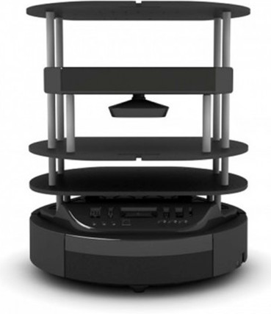
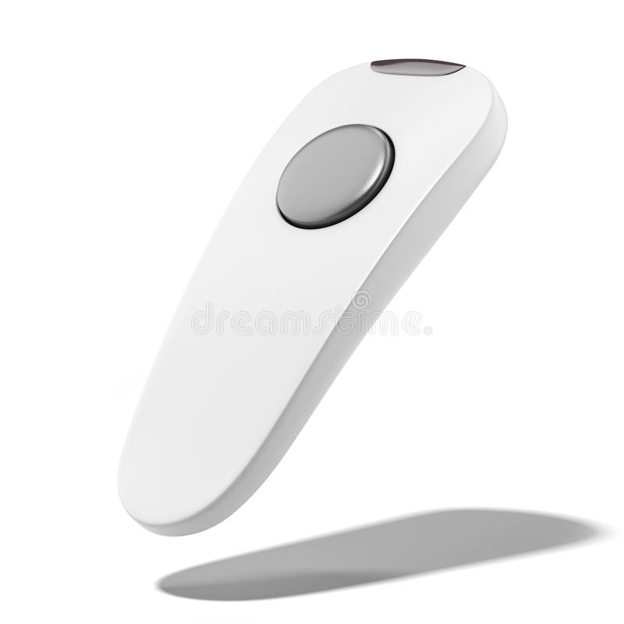
Text panel: to communicate what the robots next movement is: e.g. split, surrender…
Deck we want to shuffle
Shuffle button (press 1s and automatically shuffles all the cards until none is left)
Robot’s deck storage, and button to open it
Robot is playing: If someone presses this button the compartment opens, allowing the dealer to place the cards on it so that the robot can read them and play
Restart button (press when game is finished, to restart)
Shuffled deck
Remote to call the robot and make it move towards the person/goal
3 play modes:
You can use your own deck and use the robot only for shuffling
You can use the robot’s own deck and only use it for shuffling
You can use the robot’s own deck and make the robot play with you

